Slide 1
2019 Profitability Model for Lariat Car Rental
Capstone Project by: Luis Ruiz-Santiago
Thinkful Data Analysis Immersion Program

Slide 2
Background
What: Increase the revenue
How: Rent length and rate
Increasing maximum days?
Context
We have 22 cars that operate in the red, 8 of them losing over $1,000
$64 million in revenue
$28 million in annual costs (including insurance)
Variations by seasons?
Any branches at a loss?
Increasing rates?

Slide 3
2018 Yearly Performance

Slide 4
2018 Monthly Gross Revenues

Slide 5
Branch Performance in 2018

Slide 6
Vehicle Performance

Slide 7
Strategy 1: Eliminate cars in red
Assumptions: 1134 total rent days will re-distribute to other cars

Slide 8
Strategy 2: Eliminate and replace
Use the money now saved from the 22 cars in red, add more profitable cars
Total Losses add to $16,663, get more of the most profitable car
Assumption: Lariat can buy the same car at same price and same insurance cost

Slide 9
Strategy 3: Increase rate by 5%
Assumption: An increase in rate will result in fewer total rent length (200 days less)

Slide 10
Combined Strategies
Get rid of cars in red + buy more cars + increase rates

Slide 11
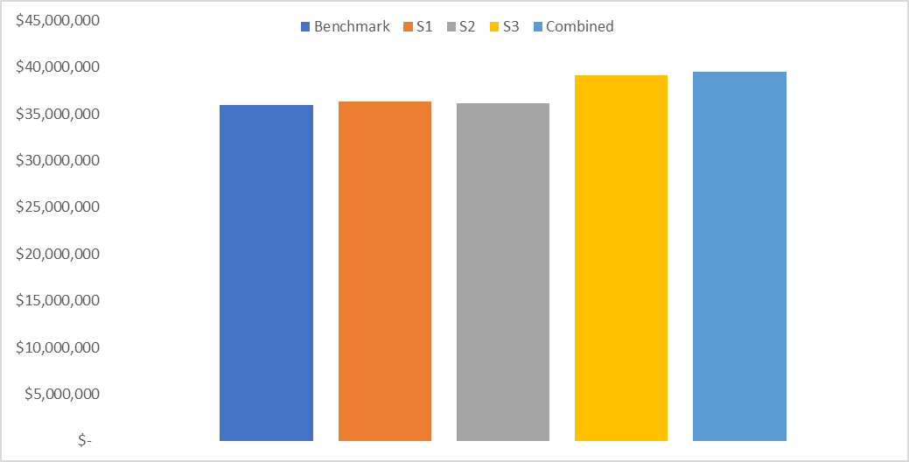
Summary

Slide 12
Recommended strategy: Increase Rates by 5% +$3 Million
Profit is most sensitive to rate:
Appeal to a different audience
Keeping cars gives exclusivity
Customer choice

